Slide 1
Introduction to AI – an eventful journey
Prof. Angel Marchev, Jr., UNWE & Sofia Uni

Slide 3
Popular definitions
Wide-ranging branch of computer science concerned with building smart machines capable of performing tasks that typically require human intelligence.
Any system that perceives its environment and takes actions that maximize its chance of achieving its goals.
Simulation of human intelligence processes by machines, especially computer systems.
Ability of a digital computer or computer-controlled robot to perform tasks commonly associated with intelligent beings.
Computerized system that exhibits behavior that is commonly thought of as requiring intelligence.
Science of making machines do things that would require intelligence if done by man.
Science and engineering of making intelligent machines, especially intelligent computer programs.
Makes it possible for machines to learn from experience, adjust to new inputs and perform human-like tasks
Leverages computers and machines to mimic the problem-solving and decision-making capabilities of the human mind.

Slide 4
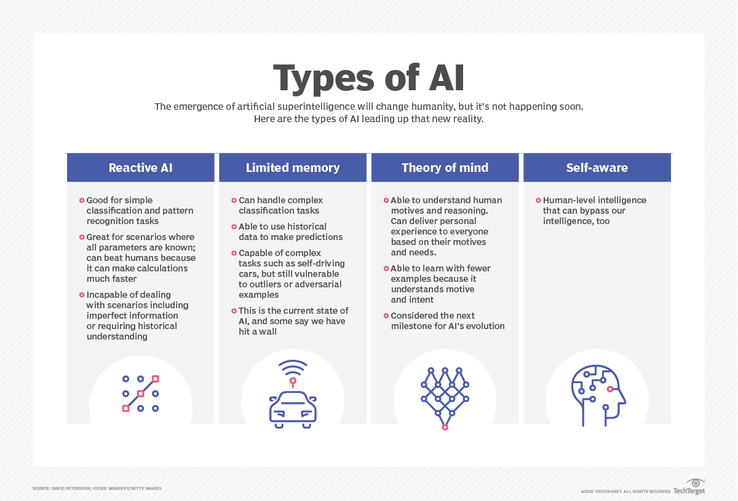

Slide 5
Auto-…
Automation describes a wide range of technologies that reduce human intervention in processes. Human intervention is reduced by predetermining decision criteria, subprocess relationships, and related actions — and embodying those predeterminations in machines.
Autonomy means independence of control. This characterization implies that autonomy is a property of the relation between two agents, in the case of robotics, of the relations between the designer and the autonomous robot. Self-sufficiency, situatedness, learning or development, and evolution increase an agent's degree of autonomy, within the strict confines of their direct environment

Slide 6
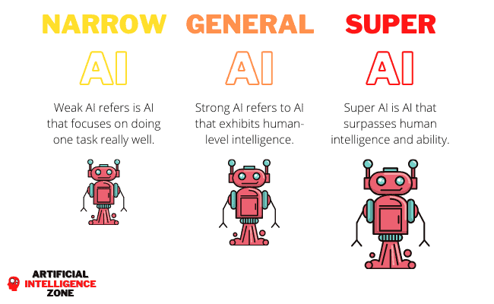

Slide 8
Goals of AI research
calculation-reaction,
decision-making / reasoning under risk & uncertainty,
prioritize and plan,
process (symbolic) knowledge (NLP),
learning (from experience / by simulation / by example),
pattern recognition,
Perception (data fusion),
ability manipulate objects.
-----------------------------------------------------
the ability to solve an arbitrary problem (General intelligence)
creativeness & Heuristics,
consciousness.

Slide 9
Purpose of AI
Deal with COMPLEXITY (Artificial or Natural):
Software systems (incl. cognitive)
Social systems (Noosphere)
Biological systems (Micro- & Macro-)
Mechanical systems (incl. electrical)
-----------------------------------------------------
Large mechanical systems (Astronomy & Planetary science)

Slide 10
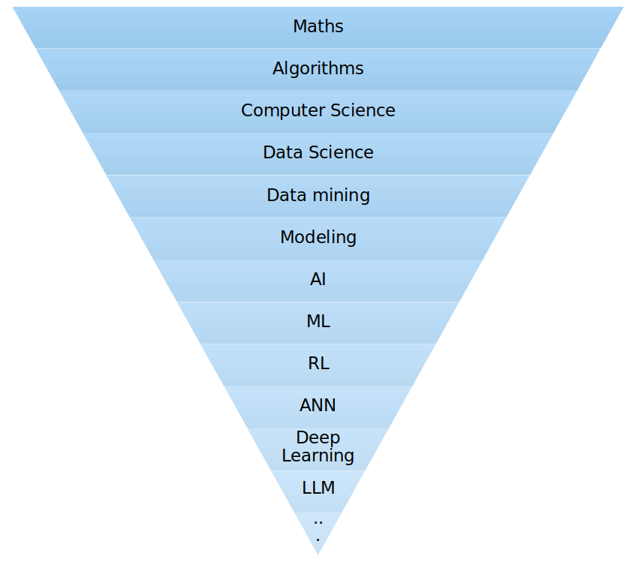

Slide 12
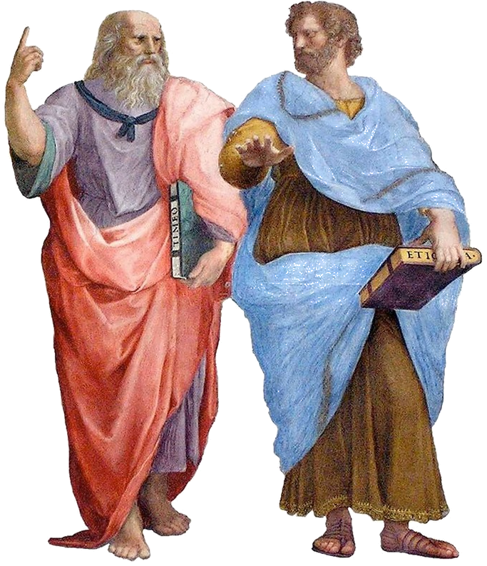
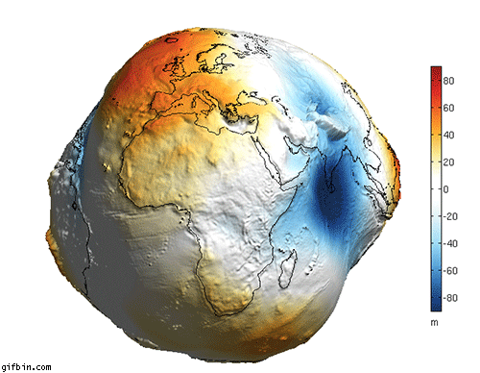
Induction/Deduction

Slide 13
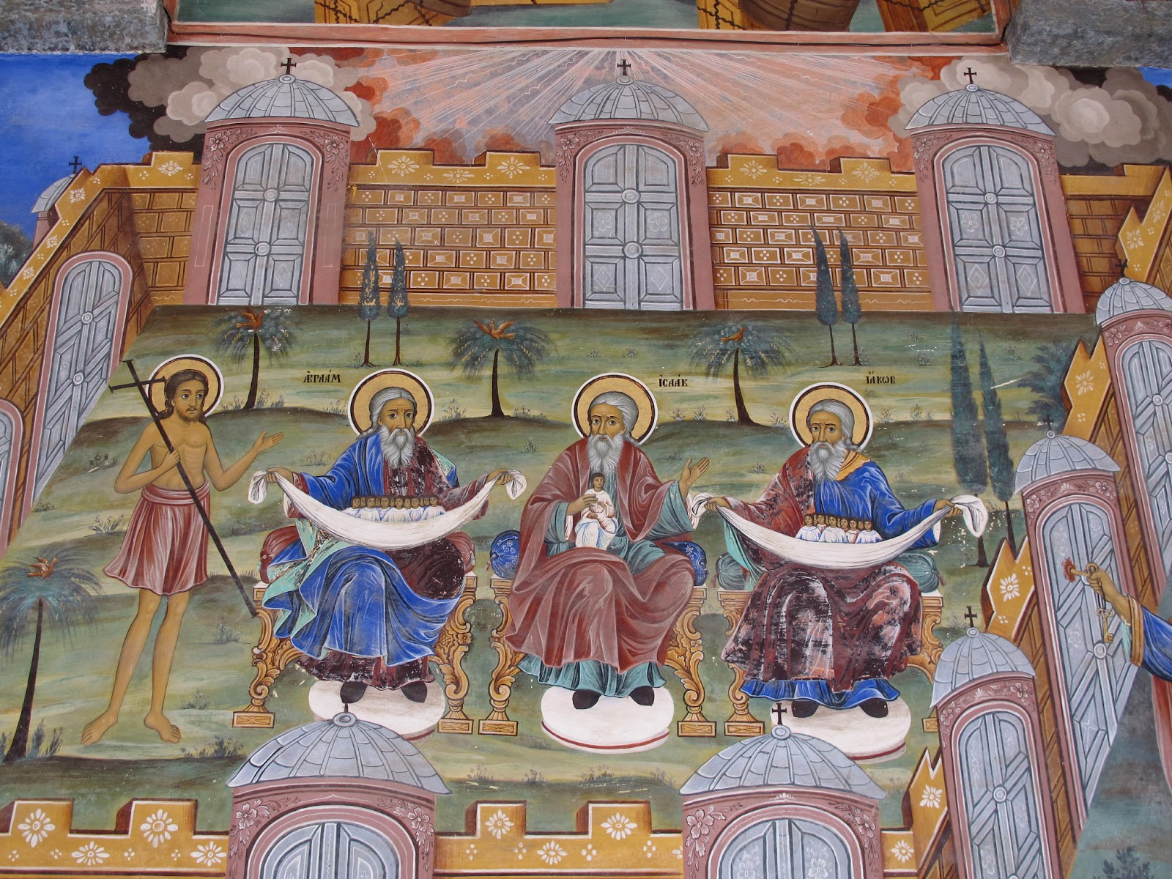
Universality / specialization

Slide 14
Стохастичен или детерминиран Свят?
ТЕЗА: „Няма нищо случайно на този свят. Случайността се дължи на непознаване на съответните причинно-следствени връзки. Детерминираността или случайността на едно събитие се свежда до познавателните способности на човека“ (класическа физика, математика)
АНТИТЕЗА: „Според принципа за неопределеност на Хайзенберг съществуват събития, причинно следствените връзки на които не могат да бъдат определени в рамките на смислено за настъпването на събитието време. Този принцип означава, че съществуват събития, които не могат да бъдат направени детерминирани, в следствие на което те са непрогнозируеми. “ (квантова физика, инженерни науки)
Проф. Георги Чобанов, VSIM:16, Равда, Септември 2016

Slide 15
Стохастичен или детерминиран Свят?
СИНТЕЗА (Марчев, мл.):
Или съществуват недетерминирани събития, при които причинно-следствени връзки няма;
Или познавателната способност на човека е незначимо малка в сравнение с всеобхватната Вселена/Вселени.
И в двата случая за използването на по-добрия (или единствения възможен) вероятностен математически апарат е предпочитано.
Особено валидно е за явленията със социално-психологически характер, които много повече се доближават до квантовата механика (принцип на наблюдателя, случайност (или необхватна сложност) на поведението на обектите, неопределеност на средата, непълна информация, нестационарност и пр.). Едновременно това е и по-прагматичния подход, при който винаги може да се разчита на конкретни числени резултати.“

Slide 16
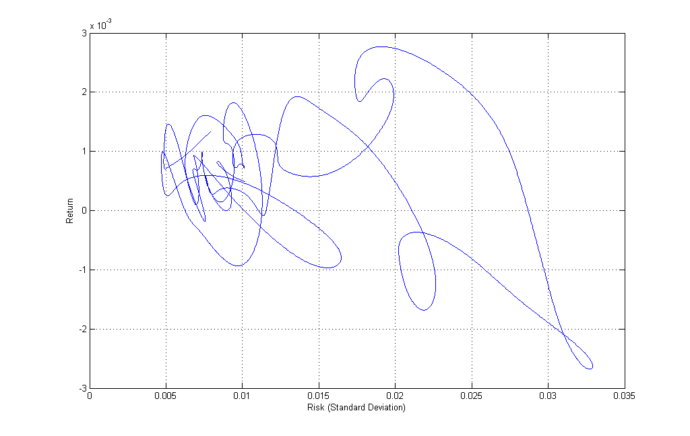
Поведение на реална система

Slide 17
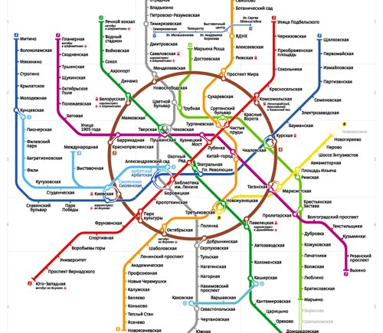
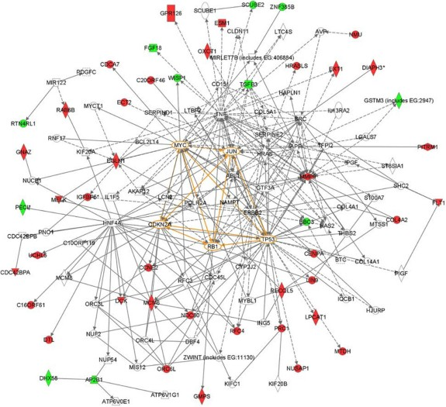
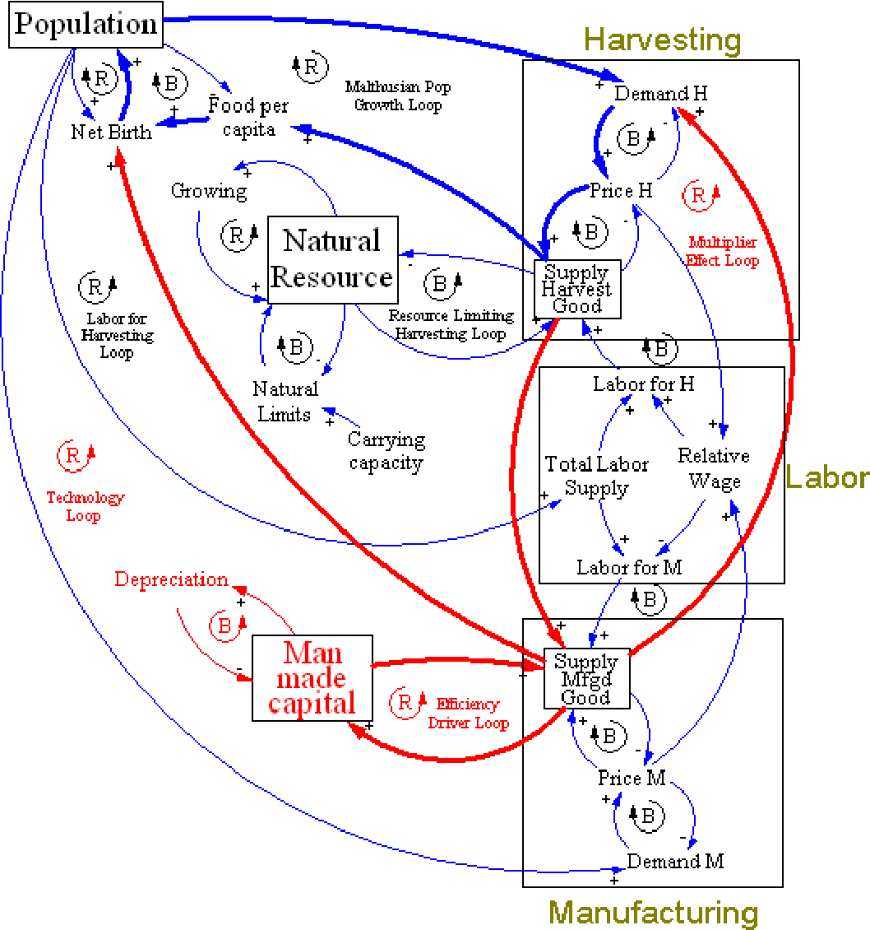
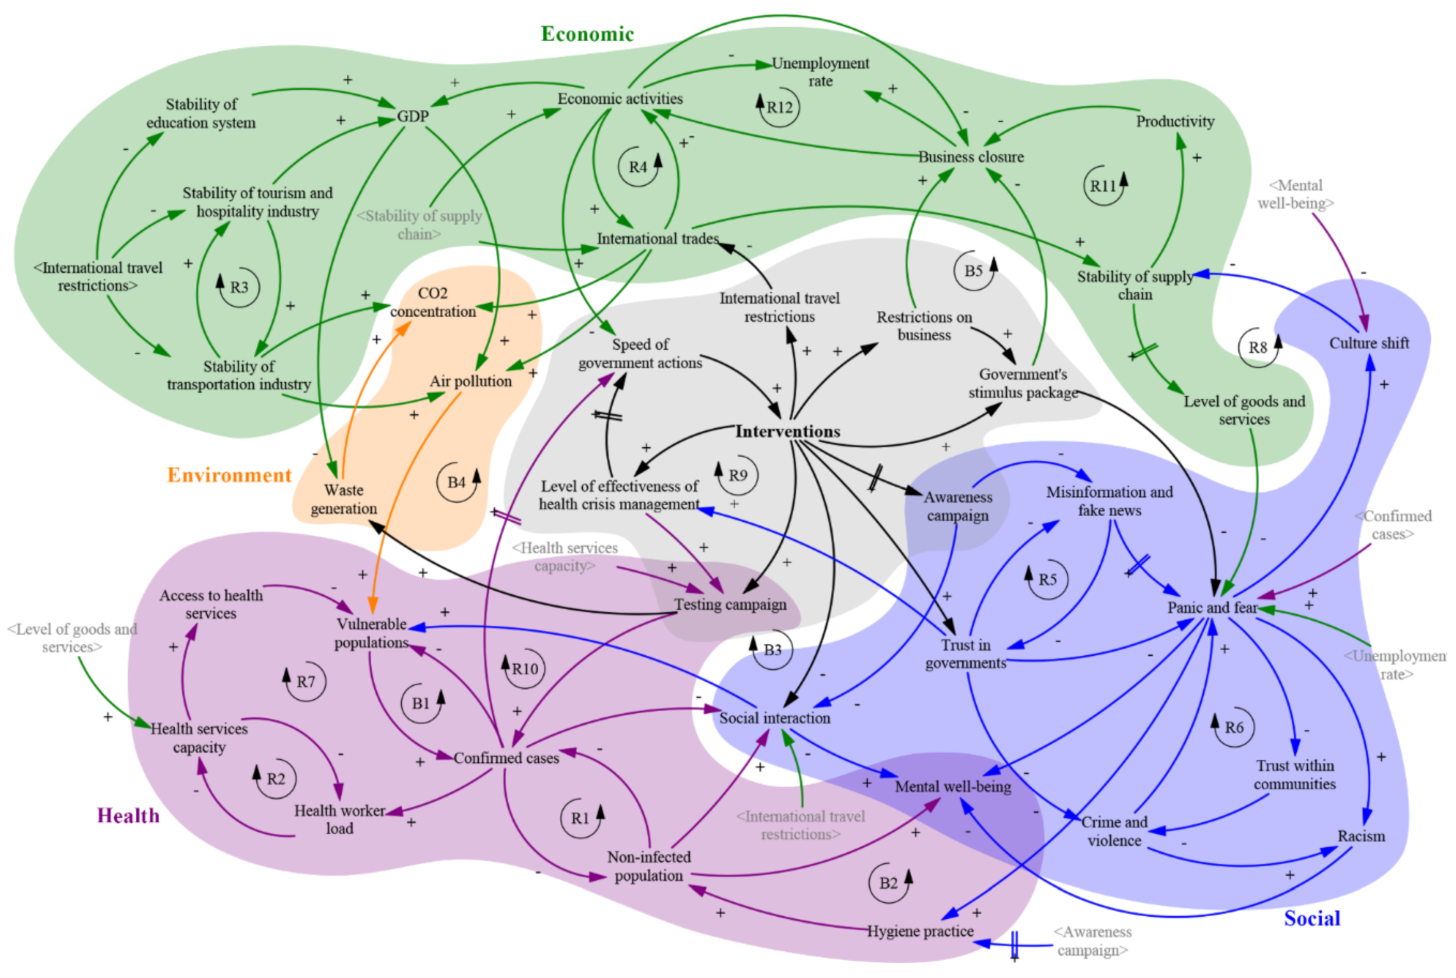
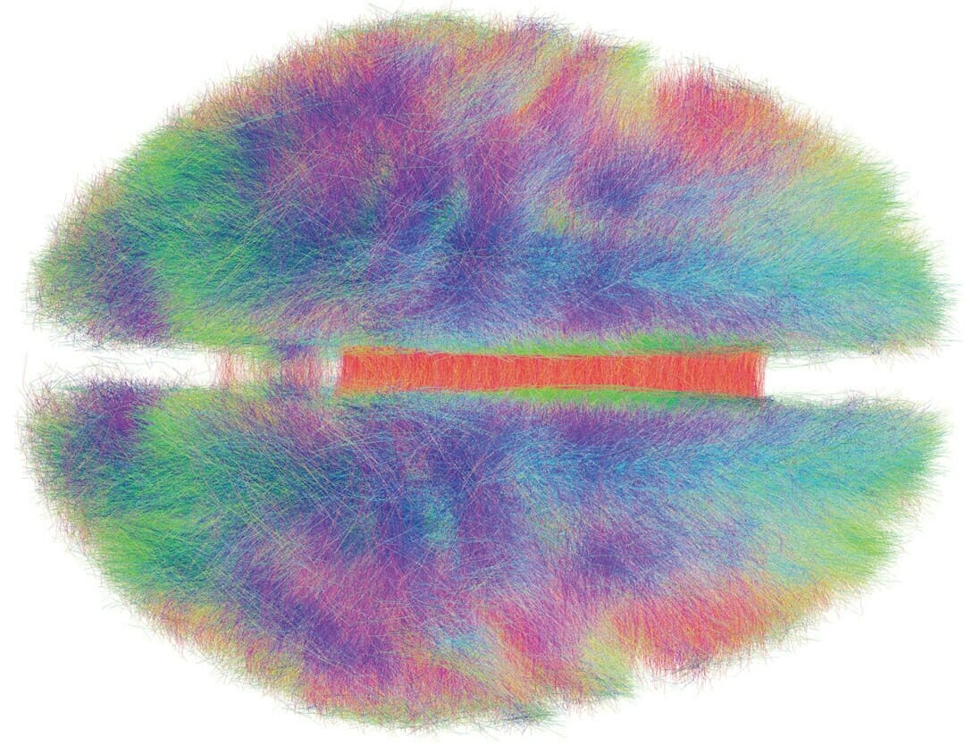
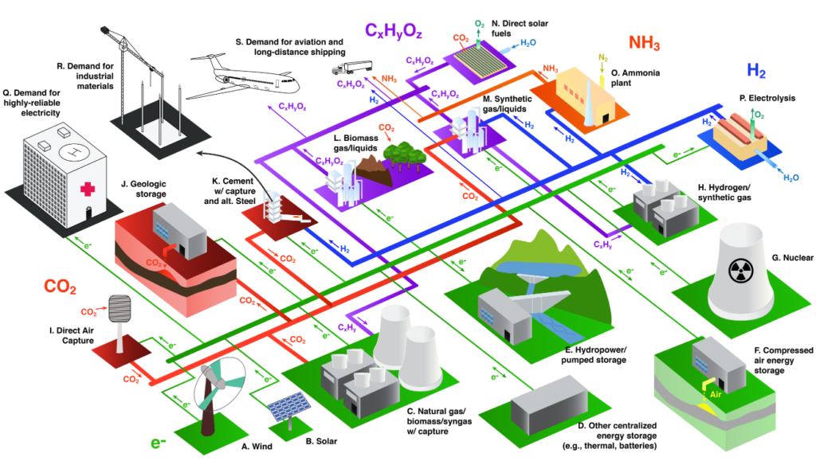
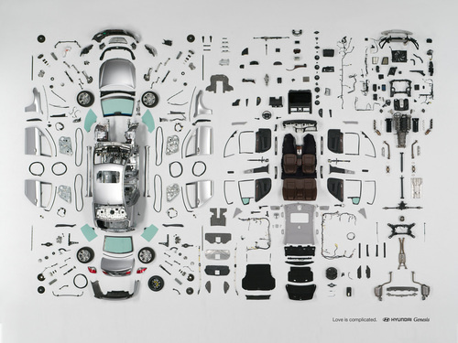
Welcome to the Complexity World
complex
sim_model
feedback
emergence
req_var
self_org
learn_mach
art_neuron
ann
gmdh
mssp

Slide 18
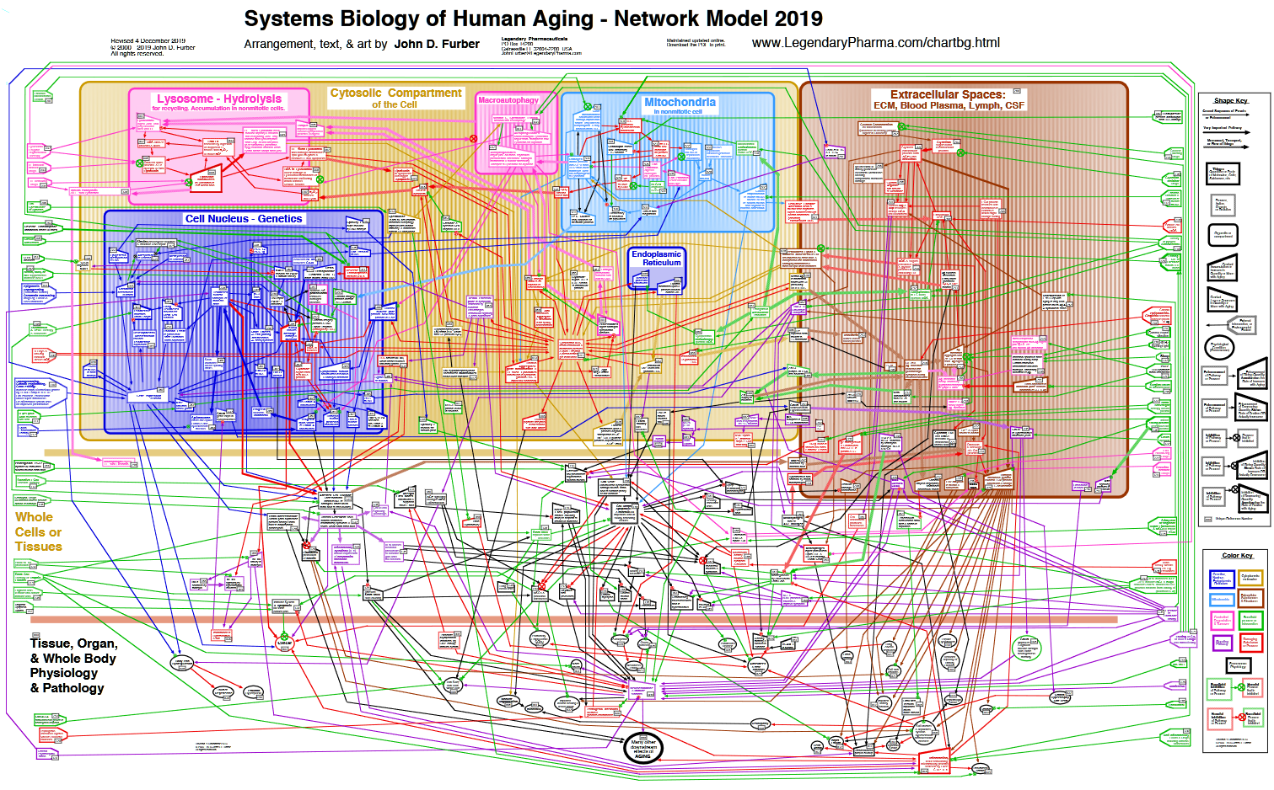

Slide 19
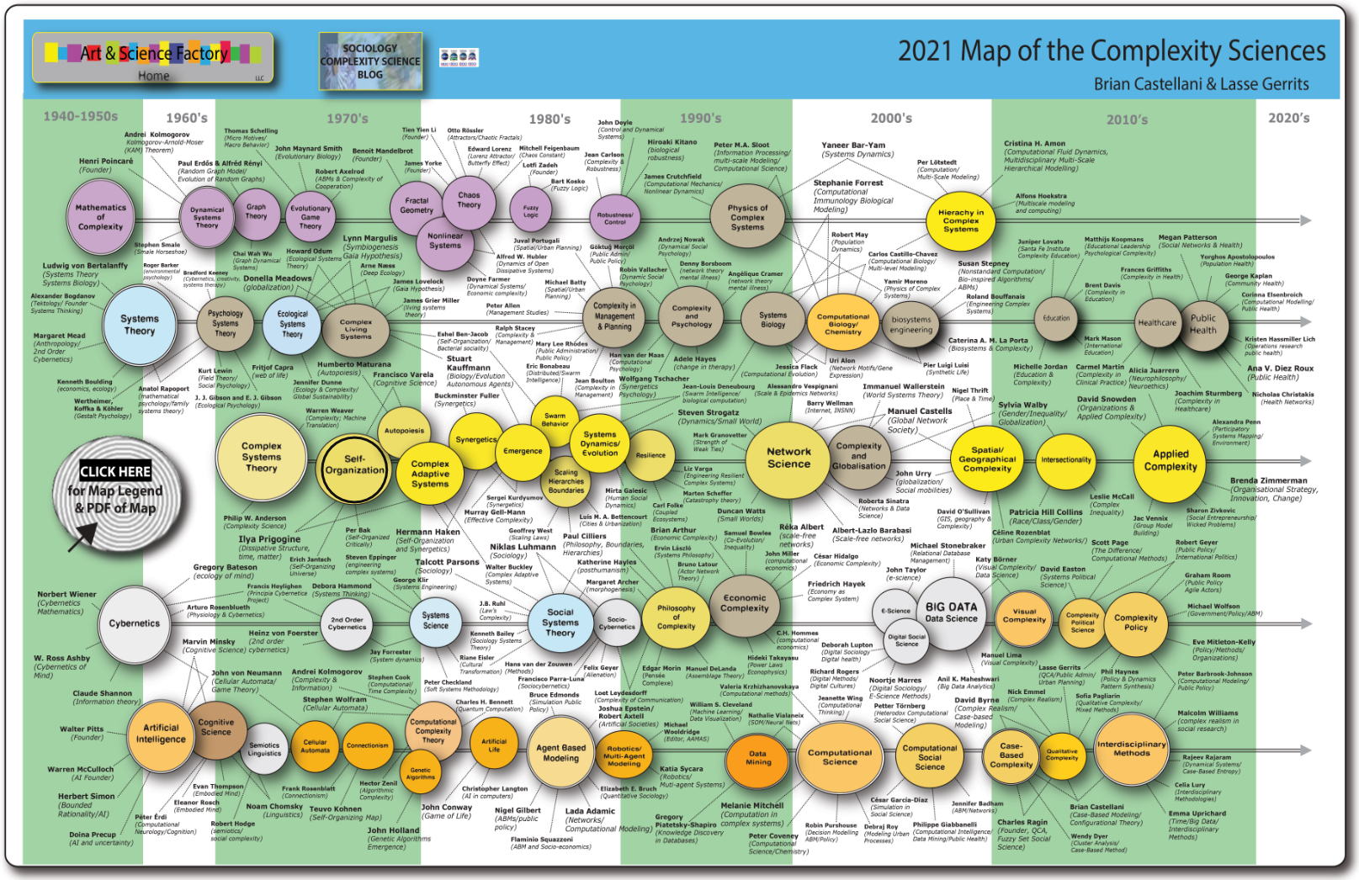
https://www.art-sciencefactory.com/complexity-map_feb09.html
complex
sim_model
feedback
emergence
req_var
self_org
learn_mach
art_neuron
ann
gmdh
mssp

Slide 20
Standing on the shoulders of giants Nanos gigantum humeris insidentes
"What Descartes did was a good step. You have added much several ways, and especially in taking the colors of thin plates into philosophical consideration. If I have seen a little further, it is by standing on the shoulders of Giants." (Newton, Isaac. 1675, “Letter from Sir Isaac Newton to Robert Hooke“)
“We are like dwarfs sitting on the shoulders of giants. We see more, and things that are more distant, than they did, not because our sight is superior or because we are taller than they, but because they raise us up, and by their great stature add to ours.“ (John of Salisbury, 1159, Metalogicon)
Greek mythology: the blind giant Orion carried his servant Cedalion on his shoulders to act as the giant's eyes.

Slide 21
Phases
Imitation (through art)
Analytical parametric methods (solving hard problems)
Iterative computation methods for state search
Adaptive computation methods

Slide 22
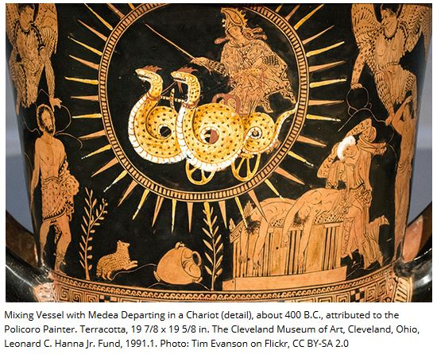
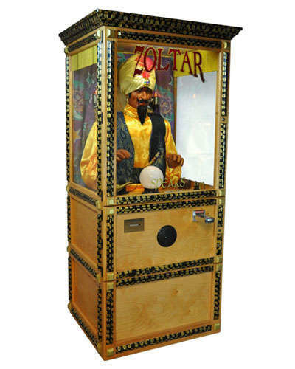
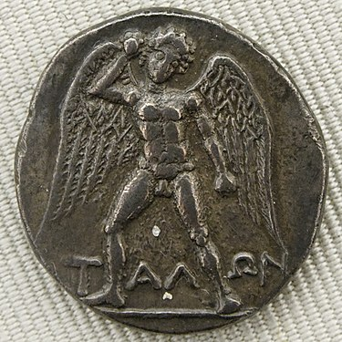
Imitation / Deus Ex Machina

Slide 23
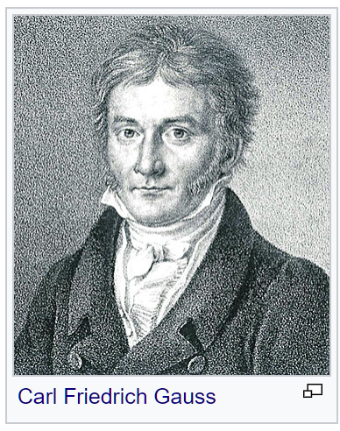
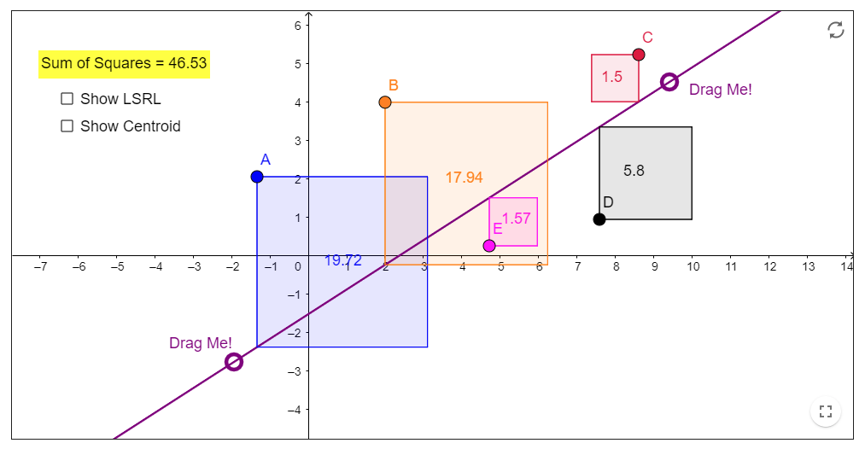
Parametric identification in linear systems Least Squares Method
Linear regression-ish
linear
logarithmic
exponential
power
reciprocal
reverse reciprocal
quadratic sum
sine
$Y=a_{0}+a_{1}.X$
$Y=a_{0}+a_{1}.lnX$
$Z=lnX$
$Y=a_{0}+a_{1}.Z$
$Y=e^{a_{0}+a_{1}.X}$
$Q=lnY$
$Q=a_{0}+a_{1}.X$
$Y=a_{0}.X^{a_{1}}$
$Q=a_{0}+a_{1}.Z$
$Y=a_{0}+\frac{a_{1}}{X}$
$Z=\frac{1}{X}$
$Y=a_{0}+a_{1}.Z$
$Y=\frac{1}{a_{0}+a_{1}.X}$
$Q=\frac{1}{Y}$
$Q=a_{0}+a_{1}.X$
$Y={\left(a_{0}+a_{1}.X\right)}^{2}$
$Q=\sqrt[2]{Y}$
$Q=a_{0}+a_{1}.X$
$Y=a_{0}+a_{1}.sinX$
$Y=a_{0}+a_{1}.Z$

Slide 24
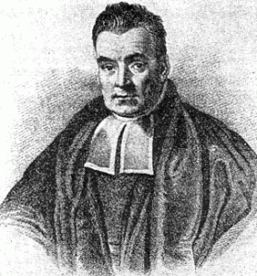
Bayes' theorem

Slide 25
The father of computing
Difference Engine
High precision automatic polynomial calculations
Analytical machine
Turing complete
Programable input
Difference Engine 2
Printing output

Slide 26
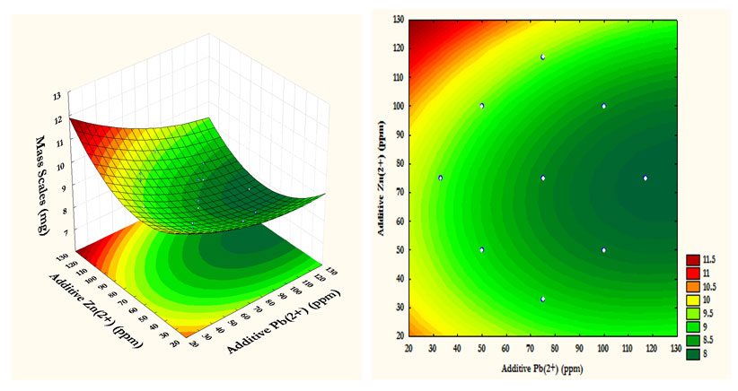
Optimization

Slide 27
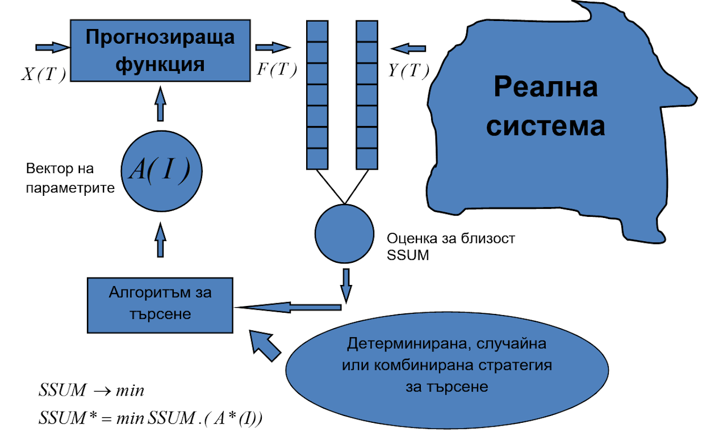
Parametric identification in non-linear systems

Slide 28
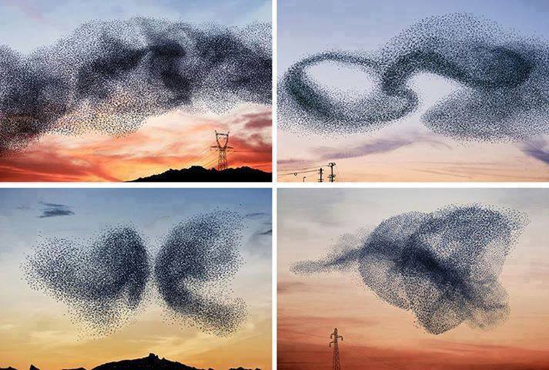
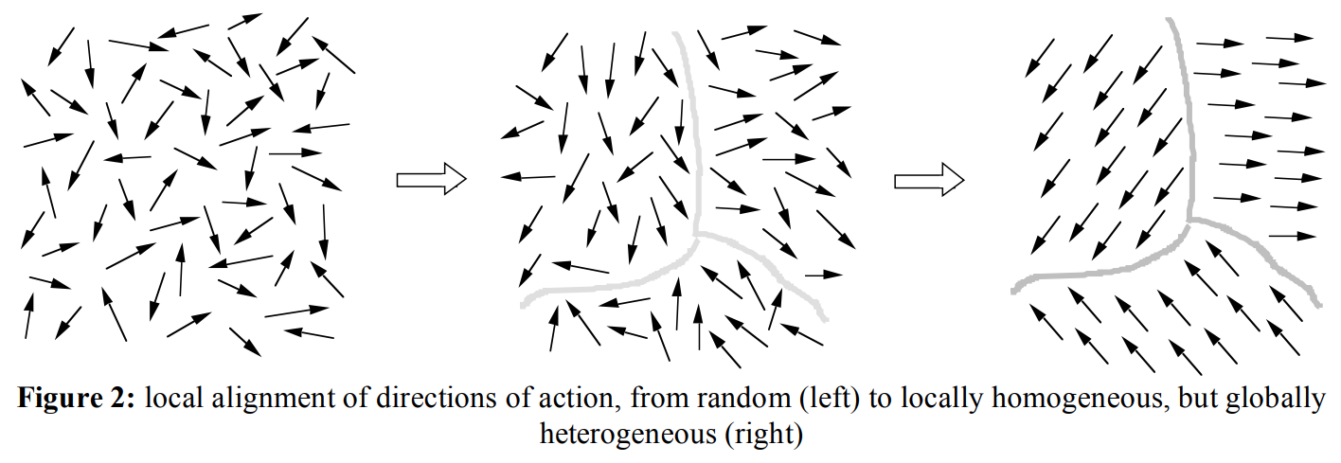
Self-organization
Structure (incl. features, models) and parametric identification

Slide 29
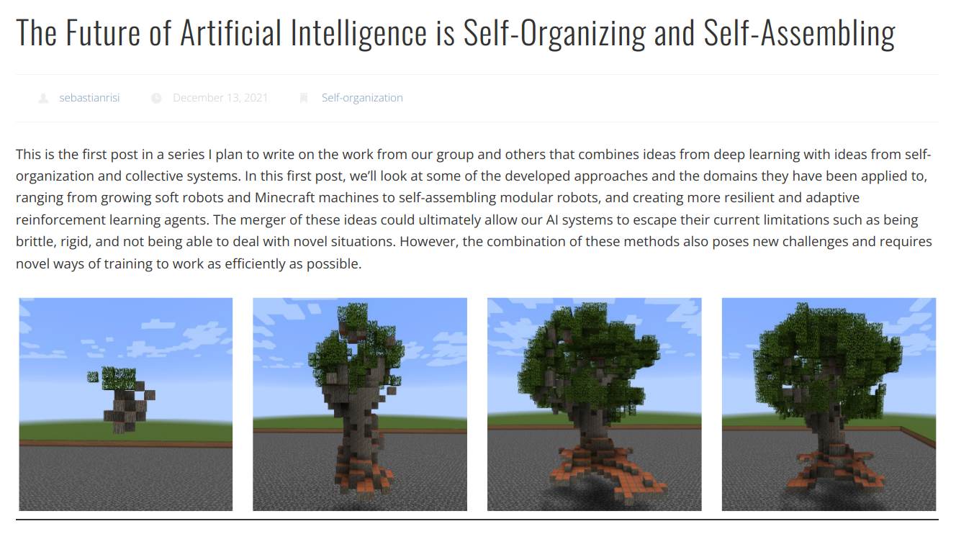
https://sebastianrisi.com/self_assembling_ai/

Slide 30
Control system
4
5
Goals
Observed influences from the environment (market factors)
Controlling influences
Unobserved influences from the environment
Insignificant variables (?)
Significant variables
Feedback
Controlled system
6
3
2
7
Controlling system
1

Slide 31
Controlling using computer model
4
5
Goals
Observed influences from the environment (market factors)
Controlling influences
Unobserved influences from the environment
Insignificant variables (?)
Significant variables
Feedback
Task for the computer model
Proposed controlled influences
Controlled system
6
3
2
7
Controlling system
1
9
8
2
computer model
7

Slide 32
Computer model with adjustment
4
5
Goals
Observed influences from the environment (market factors)
Controlling influences
Unobserved influences from the environment
Insignificant variables (?)
Significant variables
Feedback
Task for the computer model
Proposed controlled influences
Adjusting the internal structure and/or the values of the variables of the computer model
Controlled system
6
3
2
7
Controlling system
1
9
8
2
computer model
7
10
Adjustment block

Slide 33
Control system
4
5
Controlled system
Goals
Observed influences from the environment (market factors)
Controlling influences
Unobserved influences from the environment
Insignificant variables (?)
Significant variables
Feedback
Task for the simulation model
Proposed controlled influences
Adjusting the internal structure and/or the values of the variables of the simulation model
6
3
7
2
Controlling system
Controlling system
1
1
9
8
2
Simulation model
7
Systematic approach
Inductive reasoning & Empirism
Heuristics & Interdisciplinary nature
Complexity emulation
10
Self-perfection block
Self-perfection (Self-learning and/or Self-organization)
complex
sim_model
feedback
emergence
req_var
self_org
learn_mach
art_neuron
ann
gmdh
mssp

Slide 34
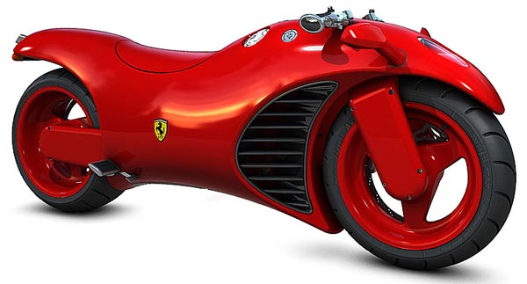
What is a model?
?

Slide 35
Simulation model definition
Purposefully created artificial system,
which:
1. Reflects the most significant features of the modeled system:
Describes the most significant (for the purpose of the research) components and connections of the modeled system;
Has behavior close enough (for the purpose of the research) to the behavior of the modeled system.
2. Provides gathering of new information about the modeled system:
By simulating the behavior of the modeled in convenient granularity scale (incl. convenient time);
By replacing to some extend (for the purpose of the research) the modeled system
By experiments with the model instead of the real system (“what… if…?”).
complex
sim_model
feedback
emergence
req_var
self_org
learn_mach
art_neuron
ann
gmdh
mssp

Slide 36
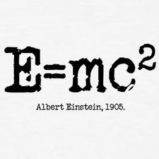
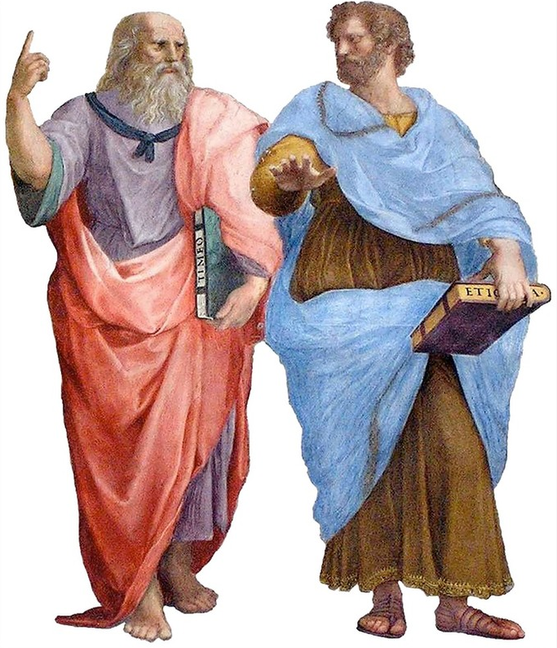
Analytical or Simulation model
Towards emulating (imitating) complexity to extract particular results (values) for decision making
Towards simplification of modeled system for generalization of principles and relationships
complex
sim_model
feedback
emergence
req_var
self_org
learn_mach
art_neuron
ann
gmdh
mssp

Slide 37
Some sources of wisdom…
http://www.youtube.com/watch?v=jS0zj_dYeBE - Igor Nikolic
Some resources
https://www.basaga.org/basaga_files/ai-sources.html
Signiture class
https://youtube.com/playlist?list=PLX9ryRl9v7BDvApmIn2Blt-BKh1OQLdWK

Slide 38
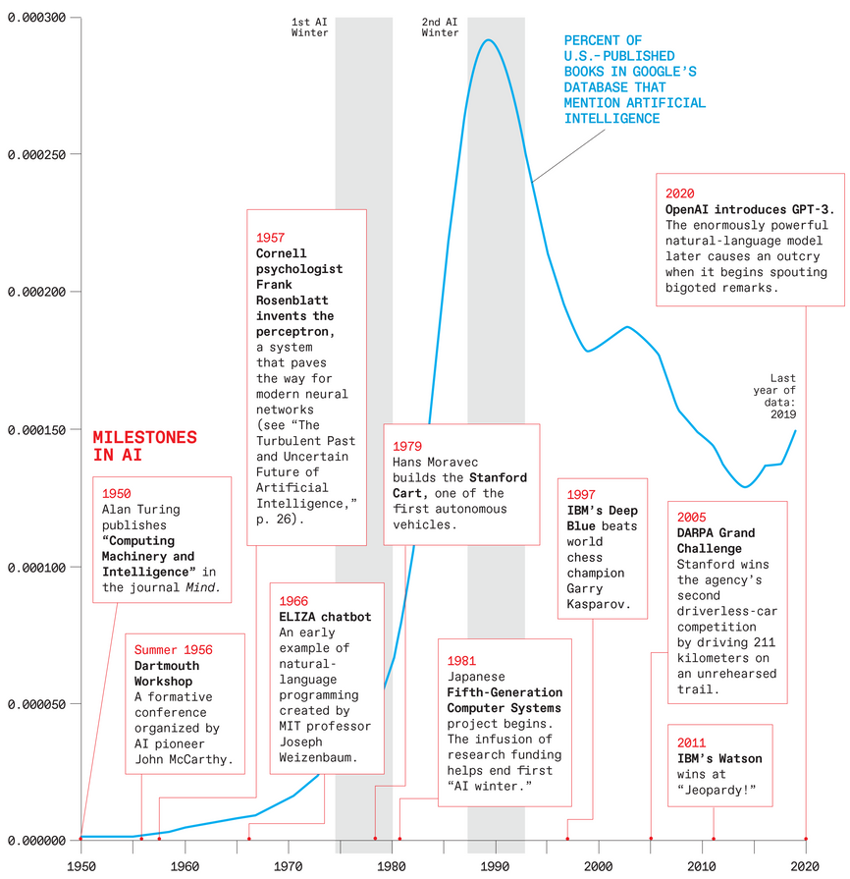
AI seasons
Pre-wave: many precursors since the ancient times
First wave: In the 1950-60s: AI was based on logical reasoning with symbols on digital computers. Those same researchers considered and rejected neural networks.
Second wave: In the 1980s:
* rule-based expert systems (symbolism) a more heuristic form of symbol-based logical reasoning
* and a resurgence in neural networks (connectivism) triggered by the emergence of new training algorithms.
Third wave: In the early 2010s, this wave gathered powerful new momentum with the rise of artificial neural networks learning from massive data sets, computing power. & modern libraries.

Slide 39
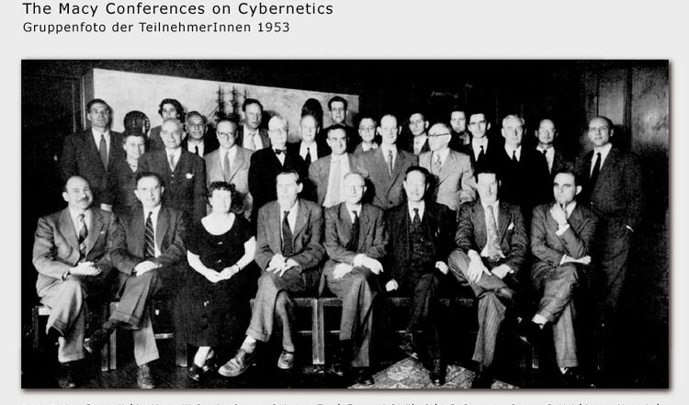
AI Founding Fathers
A story about the brightest of the bright
Several Nobel Prize laureates
Several Alan Turing Award laureates
Alan Turing himself
And several more of his contemporary peers (several not included… yet)
The scientists who have prescribed the modern World by pen & paper
Multiple notable contributions in various other domains
And by the way discovered …
… the concept of self-organization…
… a perfect illustration the emergent properties of a close-knit scientific society
complex
sim_model
feedback
emergence
req_var
self_org
learn_mach
art_neuron
ann
gmdh
mssp

Slide 40
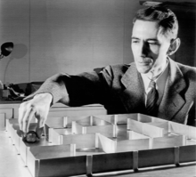
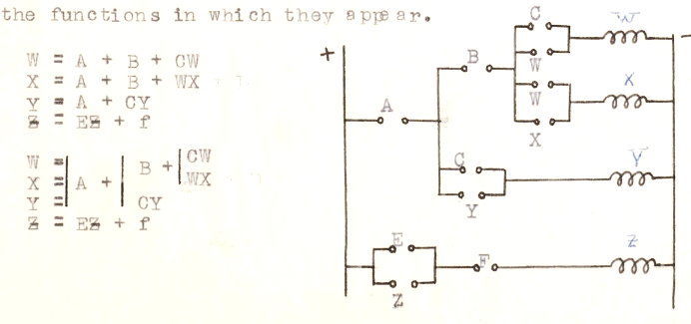
Claude Shannon Logical circuits
“A symbolic analysis of relay and switching circuits” (Master thesis 1937, paper 1938, MIT)
these circuits could solve all problems that Boolean algebra could solve
“Theseus” (1950)
complex
sim_model
feedback
emergence
req_var
self_org
learn_mach
art_neuron
ann
gmdh
mssp

Slide 41
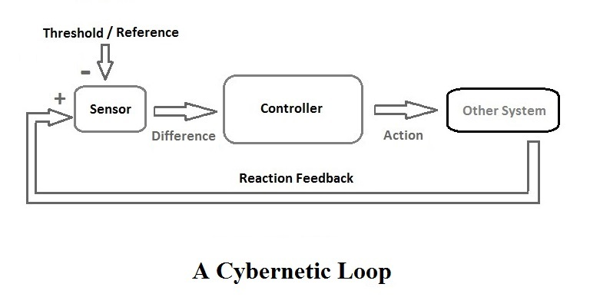
Norbert Wiener Cybernetics
“Cybernetics or Control and Communication in the Animal and the Machine” (MIT Press, 1948 & second edition 1961)
Self-regulating control systems (feedback loop)
complex
sim_model
feedback
emergence
req_var
self_org
learn_mach
art_neuron
ann
gmdh
mssp

Slide 42
Control system
4
5
1. Goals
Controlled system
2. Observed influences from the environment
3. Controlling influences
6
4. Unobserved influences from the environment
5. Insignificant variables
3
2
6. Significant variables
7
7. Feedback
Controlling system
1
complex
sim_model
feedback
emergence
req_var
self_org
learn_mach
art_neuron
ann
gmdh
mssp

Slide 43
Ross Ashby Requisite variety
“Requisite Variety and its implications for the control of complex systems” (Cybernetica, 1958)
The controlling system has to feature equal or higher variety than the controlled system
"every good regulator of a system must be a model of that system"
complex
sim_model
feedback
emergence
req_var
self_org
learn_mach
art_neuron
ann
gmdh
mssp

Slide 44
Control system
4
5
Controlled system
Goals
Observed influences from the environment (market factors)
Controlling influences
Unobserved influences from the environment
Insignificant variables (?)
Significant variables
Feedback
Task for the simulation model
Proposed controlled influences
Adjusting the internal structure and/or the values of the variables of the simulation model
6
3
7
2
Controlling system
Controlling system
1
1
9
8
2
Simulation model
7
Systematic approach
Inductive reasoning & Empirism
Heuristics & Interdisciplinary nature
Complexity emulation
10
Self-perfection block
Self-perfection (Self-learning and/or Self-organization)
complex
sim_model
feedback
emergence
req_var
self_org
learn_mach
art_neuron
ann
gmdh
mssp

Slide 45
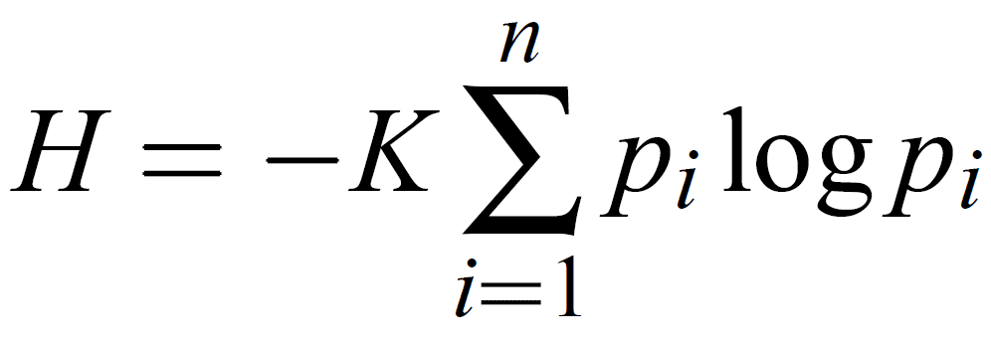
Claude Shannon Information theory
“A Mathematical Theory of Communication" (paper 1948, Bell Labs)
Channel noise & lag
Quantitative measure of information
complex
sim_model
feedback
emergence
req_var
self_org
learn_mach
art_neuron
ann
gmdh
mssp

Slide 46
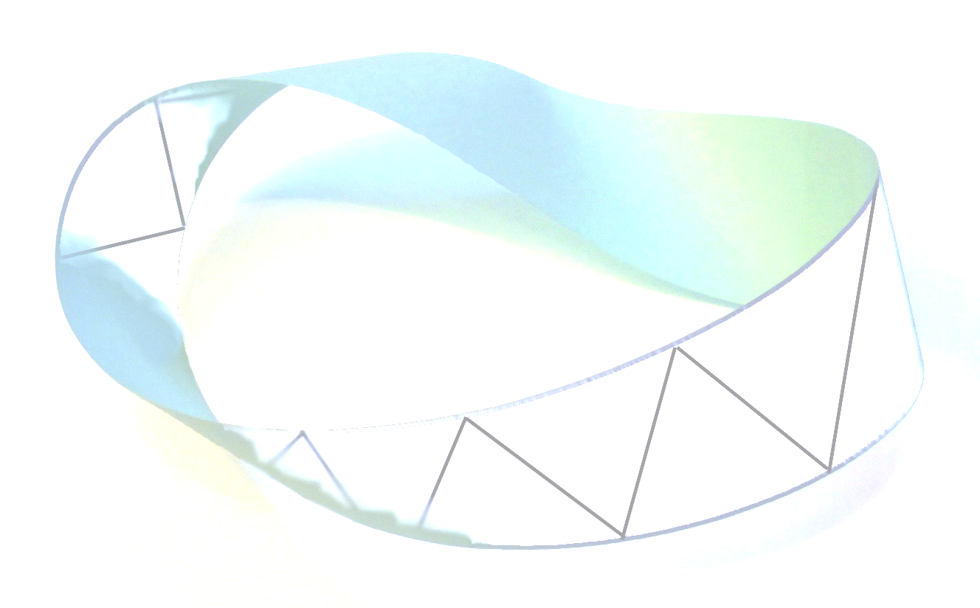
Julian Huxley Emergence
Aristotle (Metaphysics): "... the totality is not, as it were, a mere heap, but the whole is something besides the parts ..."
“Evolution and ethics 1893-1943” (MIT Press, 1948)
“passage to a totally new and more comprehensive type or order of organization, with quite new emergent properties, and involving quite new methods of further evolution.”
complex
sim_model
feedback
emergence
req_var
self_org
learn_mach
art_neuron
ann
gmdh
mssp

Slide 47
Ross Ashby Self-organization
"Principles of the Self-Organizing Dynamic System". (The Journal of General Psychology, 1947)
"Principles of the self-organizing system" (U.S. Office of Naval Research, 1962)
“Changing from bad organization [state] to good”
“Every dynamical system … is self-organizing”
complex
sim_model
feedback
emergence
req_var
self_org
learn_mach
art_neuron
ann
gmdh
mssp

Slide 48
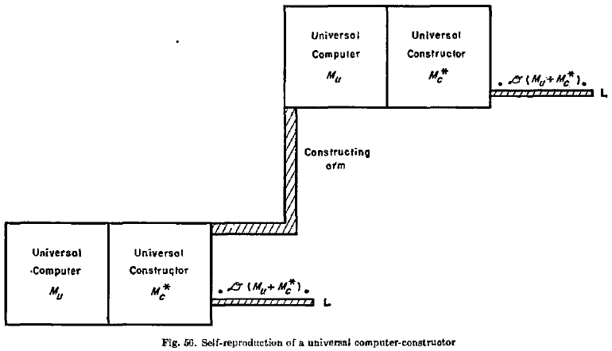
John von Neumann Self-reproduction
Multiple other contributions
“Theory of Self-reproducing Automata” (University of Illinois Press, 1948-1966)
(A) Logical universality... a class of automata ... able to perform all ... logical operations.
(B) Constructability... an automaton [being] constructed ... by another automaton.
(C) Construction-universality... [an] automaton ... be able to construct every other automaton.
(D) Self-reproduction... [an] automaton can construct other automata that are exactly like it.
(E) Evolution... the construction of automata by automata can progress from simpler types to increasingly complicated types
complex
sim_model
feedback
emergence
req_var
self_org
learn_mach
art_neuron
ann
gmdh
mssp

Slide 49
Claude Shannon Algebra for Theoretical Genetics
"An Algebra for Theoretical Genetics“ (Ph.D. Thesis, MIT, 1940)
mathematical formulation for Mendelian genetics
Recessiveness & Dominance (Mendel, 1866)
Formula for the n-th generation
complex
sim_model
feedback
emergence
req_var
self_org
learn_mach
art_neuron
ann
gmdh
mssp

Slide 50
Alan Turing Learning machines
Many other contributions
“Computing machinery and intelligence” (Mind, 1950) https://academic.oup.com/mind/article/LIX/236/433/986238
In essence - Evolutionary Computation
complex
sim_model
feedback
emergence
req_var
self_org
learn_mach
art_neuron
ann
gmdh
mssp

Slide 51
Norbert Wiener Learning & Self-reproduction machines
Partly inspired by Gabor, D., “Electronic Inventions and their Impact on Civilisation”, (Inaugural lecture), Imperial College, 1959
“Cybernetics or Control and Communication in the Animal and the Machine” (MIT Press, second edition 1961), chapter IX
“…If we program a machine for winning a war, we must think well what we mean by winning. A learning machine must be programmed by experience. The only experience of a nuclear war which is not immediately catastrophic is the experience of a war game…”
“…we can imitate any unknown non-linear transducer [Self-reproduction machine] by a sum of linear terms, each of fixed characteristics and with an adjustable coefficient…[by] feedback apparatus… ”
complex
sim_model
feedback
emergence
req_var
self_org
learn_mach
art_neuron
ann
gmdh
mssp

Slide 52
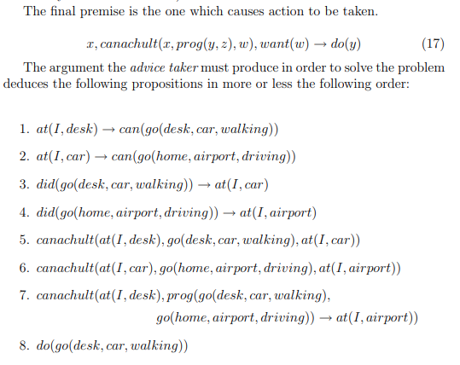
John McCarthy Artificial Intelligence
Coined the term Artificial Intelligence (Avoiding “cybernetics” and “automata”): “We propose that a 2-month, 10-man study of artificial intelligence be carried out during the summer of 1956 at Dartmouth College” w/ Marvin Minsky, Nathaniel Rochester and Claude Shannon
Programs with Common sense
LISP, ALGOL
complex
sim_model
feedback
emergence
req_var
self_org
learn_mach
art_neuron
ann
gmdh
mssp

Slide 53
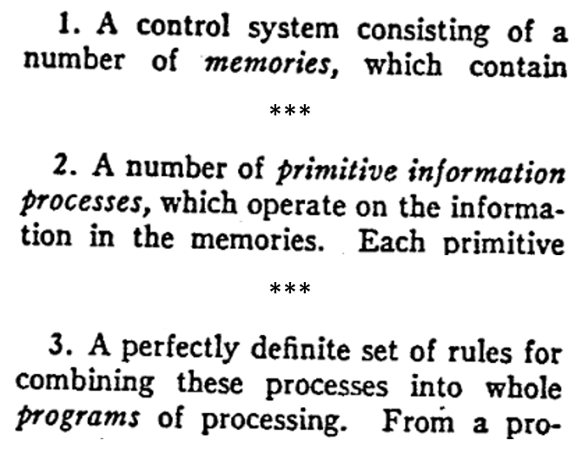
Newell, Simon & Shaw Theory of human problem solving
“Programming a Computer for playing Chess” (Shannon, 1949) => Complexity of chess - Shannon number 10¹²⁰ (1950)
“Elements of a theory of human problem solving” (Psychological review, 1958)
http://digitalcollections.library.cmu.edu/awweb/awarchive?type=file&item=33573
“problem-solving behavior in terms of … information processes… this theory Is mostly a theory of the control system…”
Logic Theorist (1956)
General Problem Solver (1959)
IPL, JOSS, Chess Play
complex
sim_model
feedback
emergence
req_var
self_org
learn_mach
art_neuron
ann
gmdh
mssp

Slide 54
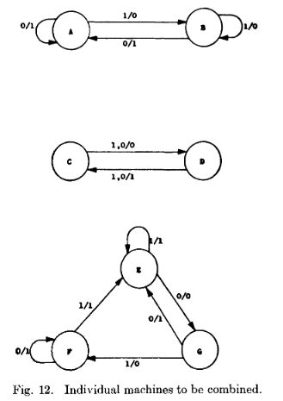
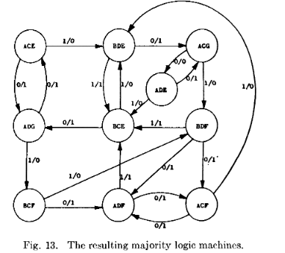
Lawrence Fogel Evolutionary programming
Autonomous automata
Fogel L. J., Owens AJ, and Walsh MJ Artificial Intelligence Through Simulated Evolution, John Wiley & Sons, Inc., New York, 1966.
complex
sim_model
feedback
emergence
req_var
self_org
learn_mach
art_neuron
ann
gmdh
mssp

Slide 55
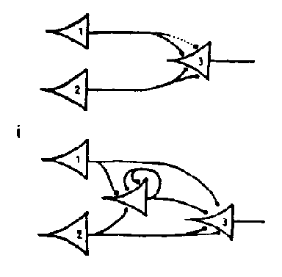
Pitts & McCullock Artificial Neuron Network
"A logical calculus of the ideas immanent in nervous activity" (The bulletin of mathematical biophysics, 1943)
Emulating the emerging complexity of a human brain
complex
sim_model
feedback
emergence
req_var
self_org
learn_mach
art_neuron
ann
gmdh
mssp

Slide 56
Frank Rosenblatt Perceptron
"Principles of Neurodynamics: Perceptrons and the Theory of Brain Mechanisms“ (Spartan Books, 1962)
Single layer hardware artificial system, created to function similarly to brain
complex
sim_model
feedback
emergence
req_var
self_org
learn_mach
art_neuron
ann
gmdh
mssp

Slide 57
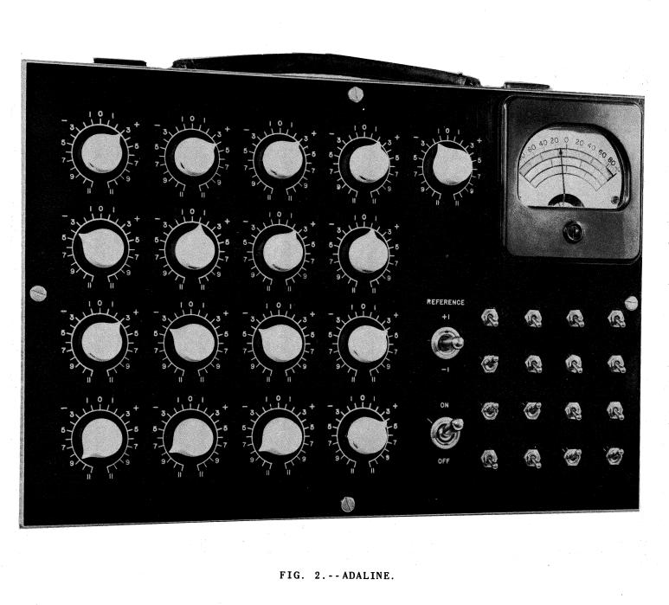
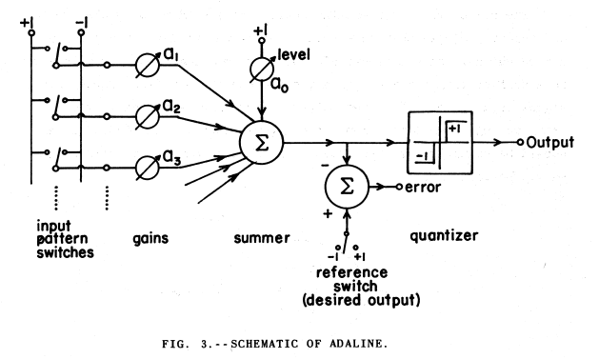
ADALINE
Bernard Widrow & Ted Hoff (Stanford University, 1960)
Adaptive Linear Element
“Adjustable neuron”
single layer ANN, multiple nodes where each node accepts multiple inputs and generates one output.

Slide 58
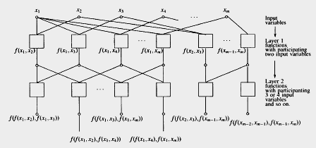
Alexey Ivakhnenko Multi-layer ANN
Multilayered neural networks architecture
Group Method of Data Handling (GMDH)
“[heuristic self-organizing modeling method ] models are generated adaptively from data in the form of networks of active neurons in a repetitive generation of populations of competing models of growing complexity.
complex
sim_model
feedback
emergence
req_var
self_org
learn_mach
art_neuron
ann
gmdh
mssp

Slide 59
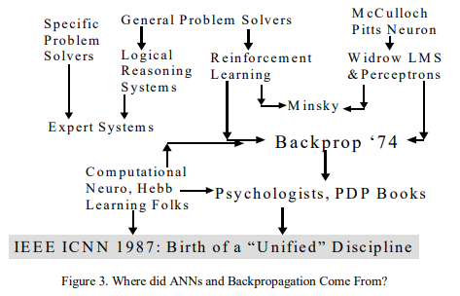
Paul Werbos Backpropagation
Backpropagation
Reinforced learning
Recurrent networks
complex
sim_model
feedback
emergence
req_var
self_org
learn_mach
art_neuron
ann
gmdh
mssp

Slide 60
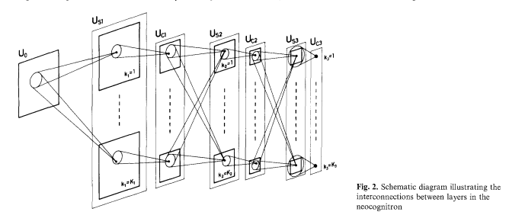
Kunihiko Fukushima Convolutional ANN
Based on findings by Hubel, D. H.; Wiesel, T. N (1962, 1965, 1977)
complex
sim_model
feedback
emergence
req_var
self_org
learn_mach
art_neuron
ann
gmdh
mssp

Slide 61
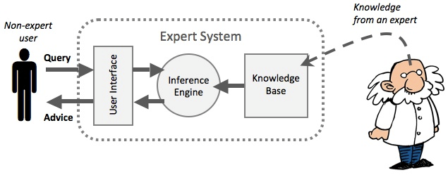
Edward Feigenbaum Expert Systems
PhD thesis (under Herbert Simon): EPAM, one of the first computer models of how people learn
DENDRAL, MYCIN, etc.
complex
sim_model
feedback
emergence
req_var
self_org
learn_mach
art_neuron
ann
gmdh
mssp

Slide 62
Advantages
Less requirements for data quality (works with noisy, incomplete and non-gradient data)
Could approximate ANY mathematical function (i.e. any type of data relations)
Using iterations gradually reduces the error by adapting to the training data set
Combined with back propagation and/or feedback algorithms, may be used for autonomous decision making
Applications
Regression
Classification
Data imputation
Pattern recognition
Extrapolation
Optimization
Autonomous decision making
Etc.

Slide 63
Artificial Neural Network
Disadvantages
Apriori set architecture, so not really self-organization (as in a brain)
More requirements for data quantity (each input node “takes up” a data point, also needs a lot of data points for learning)
Very slow to converge because it needs many iterations, (especially with complex architectures)
Could overfit on the training data set, resulting in “prediction” gap
No reasonable Explaiability
Apriori set Model specification (Structural identification, activation function)
Not really automated feature selection and/or feature engineering
complex
sim_model
feedback
emergence
req_var
self_org
learn_mach
art_neuron
ann
gmdh
mssp

Slide 64
Alexey Ivakhnenko Group Method of Data Handling
Multilayered neural networks architecture
Group Method of Data Handling (GMDH)
“[heuristic self-organizing modeling method ] models are generated adaptively from data in the form of networks of active neurons in a repetitive generation of populations of competing models of growing complexity.
complex
sim_model
feedback
emergence
req_var
self_org
learn_mach
art_neuron
ann
gmdh
mssp

Slide 65
Dennis Gabor Principle of Inconclusive Decision
also “Freedom of decisions choice”
Gabor, D. (1969), "Open-ended Planning" (chapter), Perspectives of Planning, OECD, pp. 239-350 and pp. 511-512. Paris But stated somewhat in: Gabor, D., A. Gabor (1954), "An essay on the mathematical theory of freedom", Journal of the Royal Statistic Society, Series A (General), vol. 117, part 1; (Reprinted in International Journal of Social Economics (1979), 6, pp. 330-390.)
Remarkably has 3 distinctive contributions to MSSP (self-reproducing machines, Kolmogorov-Gabor polynomials)
complex
sim_model
feedback
emergence
req_var
self_org
learn_mach
art_neuron
ann
gmdh
mssp

Slide 66
Alexey Ivakhnenko Group Method of Data Handling
Multilayered neural networks architecture
Group Method of Data Handling (GMDH)
“[heuristic self-organizing modeling method ] models are generated adaptively from data in the form of networks of active neurons in a repetitive generation of populations of competing models of growing complexity.
complex
sim_model
feedback
emergence
req_var
self_org
learn_mach
art_neuron
ann
gmdh
mssp

Slide 67
Angel Marchev, Sr. Multi-stage selection procedure
approach for autonomous synthesis of mathematical descriptions
analogous to the directed selection in genetics and biology
a large number of perspective “fighting for survival” hypotheses are evaluated
principle of inconclusive decisions
Optimal model structure, the set of effective input variables, number of layers and neurons are determined automatically
complex
sim_model
feedback
emergence
req_var
self_org
learn_mach
art_neuron
ann
gmdh
mssp

Slide 68
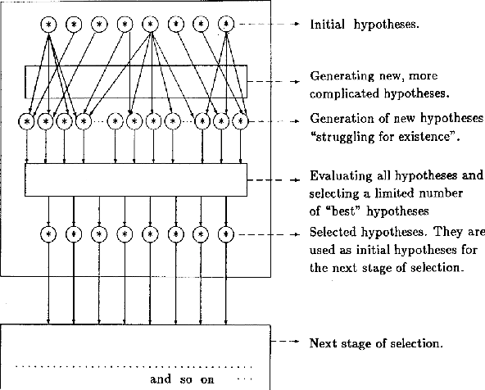
Angel Marchev, Sr. Multi-stage selection procedure
complex
sim_model
feedback
emergence
req_var
self_org
learn_mach
art_neuron
ann
gmdh
mssp

Slide 69
Angel Marchev, Sr. Multi-stage selection procedure
complex
sim_model
feedback
emergence
req_var
self_org
learn_mach
art_neuron
ann
gmdh
mssp

Slide 70
Angel Marchev, Sr. Multi-stage selection procedure
complex
sim_model
feedback
emergence
req_var
self_org
learn_mach
art_neuron
ann
gmdh
mssp

Slide 71
Multi-stage selection procedure
Advantages:
Best for modeling of complex objects or problems for which there is no identified theory (softER hypotheses)
Good for very short and noisy data samples
Overfitting is automatically avoided
Rule of layers complexity: Primitive model description is simple (building block)
Much bigger diversity of structures that can be generated
Implementation of principle of inconclusive decisions with models of gradually increasing complexity
a highly automatized procedure
complex
sim_model
feedback
emergence
req_var
self_org
learn_mach
art_neuron
ann
gmdh
mssp

Slide 72
Data availability
3rd wave

Slide 73
Algorithms
3rd wave

Slide 74
Universal approximation theorem
3rd wave
ANN represent a wide variety of functions.
with an arbitrary number of artificial neurons ("arbitrary width" case)
with an arbitrary number of hidden layers, each containing a limited number of artificial neurons ("arbitrary depth" case).

Slide 75
Computing power
3rd wave

Slide 76
3rd wave

Slide 77
Libraries
3rd wave

Slide 78
The new wave of developers
3rd wave

Slide 79
Robert Miles https://www.youtube.com/watch?v=bJLcIBixGj8

Slide 80
Robert Miles https://www.youtube.com/watch?v=bJLcIBixGj8

Slide 85
hfrl
https://www.youtube.com/watch?v=jHwHPyWkShk
https://www.youtube.com/watch?v=WO2X3oZEJOA

Slide 87
* Computerphile – LLM Diminishing return: https://youtu.be/dDUC-LqVrPU?si=SZwvYJqDudbDadg5
* No "Zero-Shot" Without Exponential Data: Pretraining Concept Frequency Determines Multimodal Model Performance
Vishaal Udandarao, Ameya Prabhu, Adhiraj Ghosh, Yash Sharma, Philip H.S. Torr, Adel Bibi, Samuel Albanie, Matthias Bethge
Rxiv:2404.04125, https://doi.org/10.48550/arXiv.2404.04125

Slide 88
Navigating Limitations.
Data Quality and Quantity.
Interfacing with Real-World Complexity.
Ethical and Technical Considerations.
Data Privacy and Security.
Balancing Efficiency and Performance.
What AI Can’t Do.
Deciphering Context.
Common Sense.
Ethical Decision-Making.
Creativity and Intuition.
https://www.mad.co/en/insights/what-ai-cant-do-yet

